Slide 1
Parallel & Distributed Computing
Lecture 1
Dr. Faisal Bin Ubaid

Slide 2
Instructor
Faisal Bin Ubaid
faisalbinubaid@iba-suk.edu.pk
Present: Assistant Professor IBA Sukkur
2015-2020: PhD Chongqing University China
2013-2015: Lecturer Military College of Signals (NUST)
MS Bahria University Islamabad 2011 -2012
BS COMSATS University Islamabad 2006-2010

Slide 3
Course Outline

Slide 4
Parallel Computing:
Involves multiple processors or computing units.
Processors communicate with each other using a shared memory space.
Coordination and communication often occur through the shared memory, allowing processors to access and update data in a common memory location.
Distributed Computing:
Involves multiple processors or computing nodes.
Processors are connected by a communication network (e.g., the internet, an intranet, or other network structures).
Each processor typically has its own local memory, and communication involves passing messages between nodes rather than sharing a common memory space

Slide 5
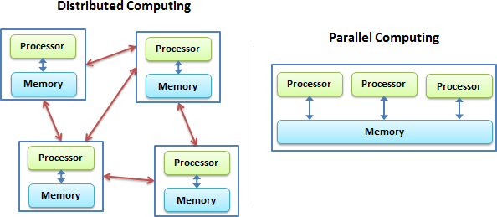
Concept | Analogy
Parallel Computing | One chef using many hands
Distributed Computing | Many chefs in different kitchens

Slide 6
Parallel versus distributed computing
Aspect | Parallel | Distributed
Machines | One | Many
Network | No | Yes
Failure impact | High | Low
Speed | Very high | Moderate
Scalability | Limited | Massive

Slide 7
Brief History of Cloud Computing
GenZ may feel like cloud computing is something from their generation, but the truth is that it actually traces its roots back over 60 years.

Slide 8
Brief History of Cloud Computing
Since the 1950s, organizations have been using an increasingly complex and ever-changing system of mainframe computers to process their data.
In the early days, mainframe computers were huge and prohibitively expensive.

Slide 9
The Time-Sharing Theory
1955 saw John McCarthy, who originally coined the term “artificial intelligence,” create a theory of sharing computing time among an entire group of users.
Getting the most out of computing time was an important consideration in the 1950s because it was a ridiculously expensive asset, and maximizing it was a top priority

Slide 10
Small companies couldn’t even afford to use computers
McCarthy’s theory of “time-sharing” would be essential in helping get the most out of the computing time available, as well as making computing time available to smaller companies that couldn’t afford to buy their own mainframes

Slide 11
A Giant Step for Cloud Computing
In the mid-1960s, an American computer scientist named J.C.R. Licklider came up with an idea for an interconnected system of computers.
In 1969, Licklider’s revolutionary idea helped Bob Taylor and Larry Roberts develop something known as ARPANET (Advanced Research Projects Agency Network).

Slide 12
ARPANET is widely known as the “predecessor of the Internet” and was the first network that allowed digital resources to be shared among computers that were not in the same physical location.
On the basis of above advancement , there was emergence of cloud computing concepts that later implemented.

Slide 13
At around in 1961, John MacCharty suggested in a speech at MIT that computing can be sold like a utility, just like a water or electricity.
It was a brilliant idea, but like all brilliant ideas, it was ahead if its time, as for the next few decades, despite interest in the model, the technology simply was not ready for it.
But of course time has passed and the technology caught that idea and after few years we had following services described in next slide

Slide 14
Salesforce.com
In 1999, Salesforce.com started delivering of applications to users using a simple website. The applications were delivered to enterprises over the Internet, and this way the dream of computing sold as utility were true.
Salesforce.com started by providing Customer Relationship Management (CRM) solutions through a web-based platform

Slide 15
Amazon
In 2002, Amazon started Amazon Web Services, providing services like storage, computation.
However, only starting with the launch of the Elastic Compute Cloud in 2006 a truly commercial service open to everybody

Slide 16
In 2009, Google Apps also started to provide cloud computing enterprise applications.
Of course, all the big players are present in the cloud computing evolution, some were earlier, some were later. In 2009, Microsoft launched Windows Azure, and companies like Oracle and HP have all joined the game.
This proves that today, cloud computing has become mainstream!

Slide 17
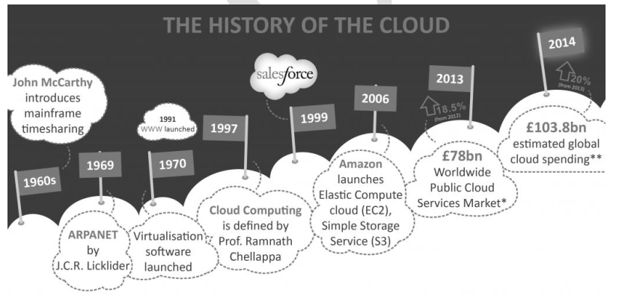
According to latest report Cloud spending is still growing strongly, led by infrastructure demand for AI and enterprise digital transformation.
Public cloud spending will exceed $720B in 2025.

Slide 18
What is cloud Computing?
Cloud computing is the delivery of computing services
including servers, storage, databases, networking, software, analytics, and intelligence over the Internet (“the cloud”)
and on a pay-as-you-go basis.

Slide 19
So How is the cloud different from the traditional client-server model of the Internet?

Slide 20
cloud vs traditional client-server model
The Internet has always been made up of servers, clients, and the infrastructure that connects them
Clients make requests of servers, and servers send responses
The cloud still uses client–server communication, but it:
hides physical servers
adds virtualization
adds elastic scaling
adds service models (IaaS, PaaS, SaaS)

Slide 21
Example
Imagine using a photo editing app on your phone:
Without cloud computing: The phone's hardware would process all image transformations (e.g., filters, effects, AI enhancements).
With cloud computing: The app sends the photo and your chosen effect to a cloud server. The server applies the effect using its powerful resources and sends the result back to your phone.
This approach enables clients (like smartphones, browsers, or IoT devices) to remain lightweight while benefiting from the immense computing power of the cloud.

Slide 22
Example
A smart home security camera (e.g., Ring, Nest) is an IoT device that captures video and sends it to the cloud for processing.
The cloud performs heavy tasks like motion detection, facial recognition, and video storage, while the device remains lightweight and power-efficient.
Users interact with the system via apps or browsers, benefiting from real-time access and advanced cloud-powered features.

Slide 23
Example
Google Drive allows users to store files in the cloud. Instead of just requesting files from a server, users can upload, edit, and manage files directly in the cloud, with Google’s servers handling the storage, processing, and synchronization across device

Slide 24
Other key differences
Resource Location and Ownership:
Traditional Client-Server Model: Applications and data are hosted on organization-owned servers in on-premises data centers.
Cloud Computing: Cloud services, including servers, storage, and applications, are hosted and managed by third-party vendors; users don't own the physical infrastructure.

Slide 25
Other key differences .
Scalability:
Traditional Client-Server Model: Scaling involves investing in additional hardware and infrastructure, requiring time and upfront investment.
Cloud Computing: Cloud services offer on-demand scalability, allowing users to adjust resources based on needs, promoting cost efficiency and agility.

Slide 26
Other key differences ..
Accessibility and Location Independence:
Traditional Client-Server Model: Access is typically limited to local networks or VPNs, requiring physical presence or complex setups for remote access.
Cloud Computing: Cloud services are accessible over the internet, providing flexibility for remote access from various locations and devices.

Slide 27
Other key differences …
Cost Model:
Traditional Client-Server Model: Organizations bear upfront costs for hardware, software, data centers, and IT staff.
Cloud Computing: Cloud services operate on a pay-as-you-go or subscription model, avoiding large upfront capital expenditures, making it cost-effective for varying workloads.

Slide 28
Other key differences ….
Maintenance and Updates:
Traditional Client-Server Model: Organizations manage maintenance, updates, and security, potentially leading to downtime.
Cloud Computing: Cloud service providers handle infrastructure maintenance, updates, and security, allowing users to focus on application use without managing the underlying infrastructure.

Slide 29
How does cloud computing work?
Rather than owning their own computing infrastructure or data centers, companies can rent access to anything from applications to storage from a cloud service provider
They can avoid the upfront cost and complexity of owning and maintaining their own IT infrastructure, and instead simply pay for what they use, when they use it.
In turn, providers of cloud-computing services can benefit from significant economies of scale by delivering the same services to a wide range of customers.

Slide 30
Examples of cloud computing
Consumer services like Gmail or the cloud backup of the photos on your smartphone , OneDrive etc
Some large enterprises host all their data and run all of their applications in the cloud.
Netflix as an Example: Netflix is a prime example of a company relying on cloud computing services. It uses Amazon Web Services (AWS) to host its video-streaming service and various business systems. This allows Netflix to scale its infrastructure based on demand, ensuring a smooth streaming experience for users worldwide.

Slide 31
Cloud computing is not just for organizations and businesses
it’s also useful for the average person as well
It enables us to run software programs without installing them on our computers
it enables us to store and access our multimedia content via the internet
it enables us to develop and test programs without necessarily having servers and so on
Cloud computing is a 21st-century marvel that holds its importance in almost every field you can think of!

